Slide 1


FinLens: AI-Powered Financial Decision Guidance System
The Credit Score for Your Financial Documents

Slide 2

The Problem: Why Millions Make Costly Mistakes
The Stakes
A missed prepayment clause on a ₹50L home loan costs ₹8–12L in unnecessary interest over 20 years — money lost to fine print.
The Existing Gap
Lawyers charge ₹5–10K per document and are slow. ChatGPT hallucinates with no audit trail. Bank advisors are biased. Comparison sites offer no personalization or market benchmarking.
The Real Problem
No system today combines legal clarity, quantitative scoring, and live market context in one explainable, auditable recommendation.

Slide 3
Our Solution: Explainable, Scored, Personalized
FinLens Reads
FinLens Scores
Multiple documents, understanding your full profile — age, income, risk appetite, and existing EMIs — before drawing any conclusion.
Each option with a defensible 0–100 Exposure Score — not an opinion, a number you can audit and defend.
FinLens Simulates
FinLens Explains
What-if scenarios live — tenure, prepayment, rate shifts — powered by a real quantitative pricing engine, not static tables.
Every recommendation with a visible trace: which clause, which agent, which data source drove the call. Fully auditable.

Slide 4
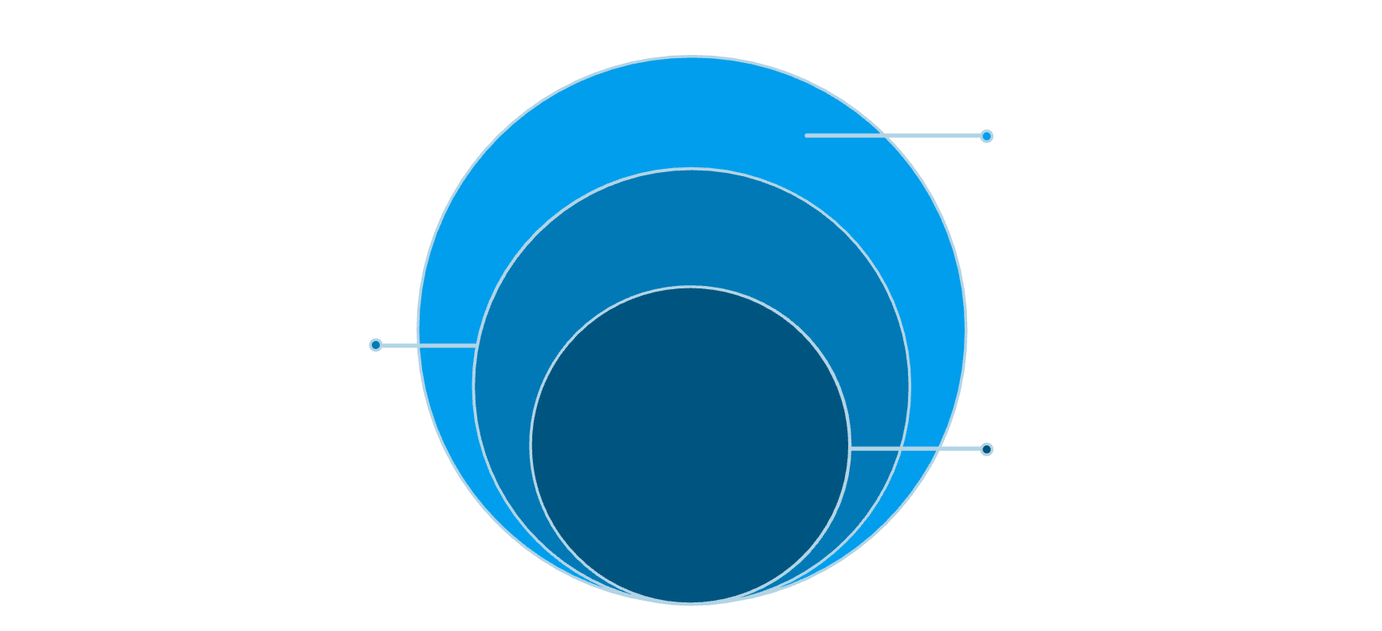
System Architecture: LLM + Quant Engine
Two Distinct Paths — One Output
The system is deliberately split into an LLM reasoning pipeline and a quantitative engine that converge only at the Trade-Off Engine. This is not an LLM wrapper.
Edge & Data
React/TypeScript → FastAPI; Tavily live search, fallback dataset, SQLite/Postgres
Frontend: React + TypeScript — document upload, What-If Simulator, dashboard
Backend: FastAPI + Python — routing, orchestration, database
AI Pipeline: LangGraph multi-agent powered by Claude
Quant Engine: GMM, Black-Scholes, Monte Carlo, Ridge/Lasso/ElasticNet — built and validated independently
Data: Live Tavily search + curated fallback, SQLite/PostgreSQL
AI Pipeline
LangGraph multi-agent: Classifier, Extractor, Clause-Risk Classifier
Core Engine
Financial Intelligence: GMM, BS, Monte Carlo, Ridge/Lasso/ElasticNet

Slide 5
Technology Stack: Why Each Choice Matters
React + TypeScript
FastAPI
LangGraph
Type-safe, responsive UI for document upload and interactive simulation. Compile-time guarantees prevent runtime UI failures.
Async, production-ready backend. Pydantic enforces strict schema validation at every API boundary — no silent data corruption.
Multi-agent orchestration with per-agent testability and auditability. Not one monolithic prompt — each agent can be tested and swapped independently.
Claude + Tavily
Quant Stack
Claude handles extraction and reasoning; Tavily provides live market search. Grounded responses, not hallucinated market data.
scikit-learn (GMM), NumPy/SciPy (Black-Scholes, Monte Carlo) — validated independently before integration into the pricing backbone.

Slide 6

Multi-Agent Pipeline: The Document Understanding Layer
Agent 3: Our Original Contribution
The Clause-Risk Classifier is the part of this project that is ours — not the LLM's.
It labels each extracted clause by risk category using a designed rubric:
Agent 1: Classifier
Agent 2: Extractor
Penalty severity
Lock-in duration
Rate volatility exposure
Exit cost
Term transparency
Agent 3: Clause Risk
Each agent is independently testable and replaceable — separation of concerns is enforced by design.
This classification layer operates independently of a single LLM call, making it auditable, consistent, and testable against historical outcomes.

Slide 7





Financial Exposure Score: The Headline Output
25%
20%
20%
Penalty Severity
Lock-in Duration
Rate Volatility
Prepayment charges, foreclosure penalties
Years you're contractually bound
Fixed vs. floating rate exposure
20%
15%
Exit Cost
Transparency
Processing fees, surrender charges
Clarity of terms and disclosure quality
Loan A — 3% penalty, 5-year lock-in, fixed rate → Score: 72
Loan B — 5% penalty, 10-year lock-in, floating rate → Score: 41
The 31-point difference is driven by lock-in duration and rate volatility exposure — quantified, not opinionated. Weights were chosen via domain expert consultation and validated against historical loan outcomes.

Slide 8

Financial Intelligence Engine & What-If Simulator
The Engine
Built Independently — Then Integrated
Live market search via Tavily, cross-checked against curated fallback data. Regime detection via GMM (bull/bear/sideways). Scenario pricing via Black-Scholes & Monte Carlo. Liquidity-shock detection via Ridge/Lasso/ElasticNet.
This module was developed and validated as a prior quantitative trading platform. It was not built to support a demo — it was integrated as the proven pricing backbone of FinLens.
What-If Simulator
Interactive sliders for tenure, prepayment, rate shift, and horizon trigger live recompute through the engine — not a static lookup table. Same document, different user profiles (age 25 vs. age 60) yield different outcomes.

Slide 9
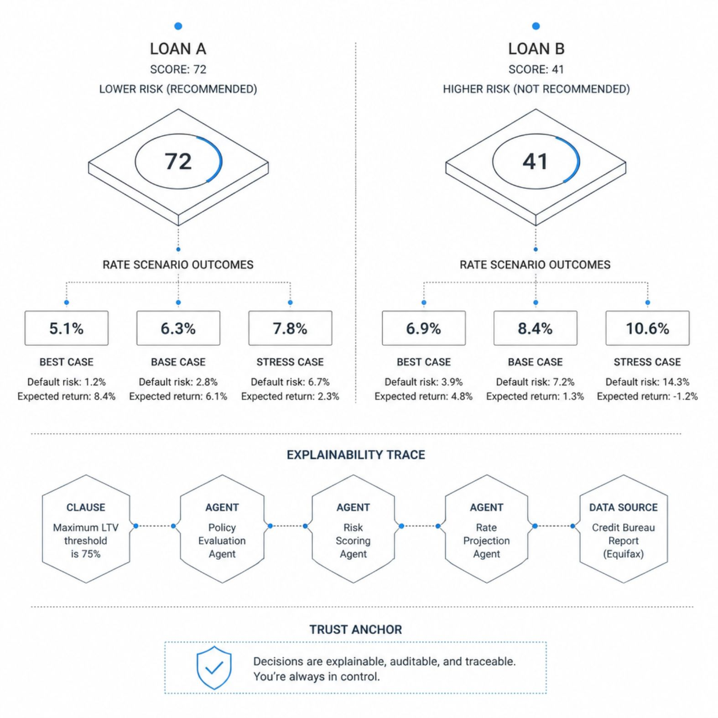

Trade-Off Engine & Recommendation Dashboard
What the Dashboard Delivers
Instead of "this is cheapest," the Trade-Off Engine says: "this is better for YOUR goals."
It combines Exposure Score, clause-risk labels, and live What-If outcomes into a single, personalized recommendation.
Dashboard components:
Exposure Score + Risk Level
Side-by-side Comparison Table
Pros/Cons per document
Recommendation with reasoning
Source links
Explainability Trace — which clause, which agent, which data source
Every recommendation ships with a visible trace — the direct answer to: "How do you avoid hallucination?"

Slide 10
Competitive Advantage & Future Scope
Where FinLens Wins
Future Scope
Alternative
Limitation
FinLens Edge
Credit cards, mutual funds, and bank API integration
Lawyers
₹5–10K/doc, slow, no comparison
Instant, ₹0, multi-doc comparison
Mobile app + enterprise version for institutional use
Generic AI (ChatGPT)
Hallucinations, no audit trail, no quant engine
Scored, explainable, quant-backed
Extend Financial Intelligence Engine to options & derivatives-backed products
Comparison Sites
No personalization, no clause analysis
Profile-driven, live benchmarking, What-If
Bank Advisors
Inherently biased toward products
Neutral, auditable scoring rubric

Slide 11
Live Demo & Impact
01
02
03
Open & Upload
AI Processing
Exposure Score
Navigate to FinLens, upload one or more financial PDFs via the React dashboard
LangGraph pipeline runs — Classifier → Extractor → Clause-Risk Classifier — with live status updates
Dashboard renders the 0–100 Exposure Score, risk labels, and side-by-side comparison table
04
05
What-If Simulation
Recommendation + Trace
Interact with live sliders — tenure, prepayment, rate shift — to see the quant engine recompute in real time
Final recommendation rendered with full explainability trace: clause → agent → data source
₹12L
6mo
85%+
Potential Savings
Build Timeline
Classifier Accuracy
Per consumer on a ₹50L home loan — recoverable by catching one missed prepayment clause
4–5 engineers, modular architecture enabling parallel development and independent testing
Clause-Risk Classifier validated on 100+ documents against historical loan outcomes

